Slide 1
SUPERLATIVE ADJECTIVES

Slide 2
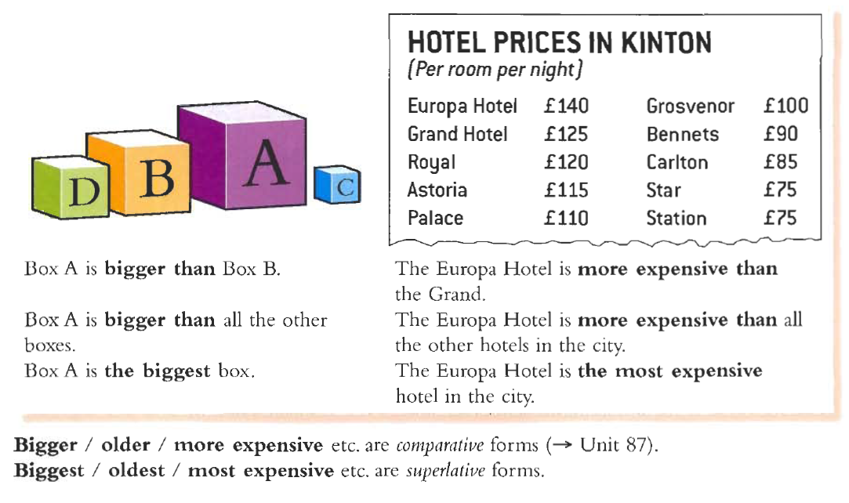

Slide 3
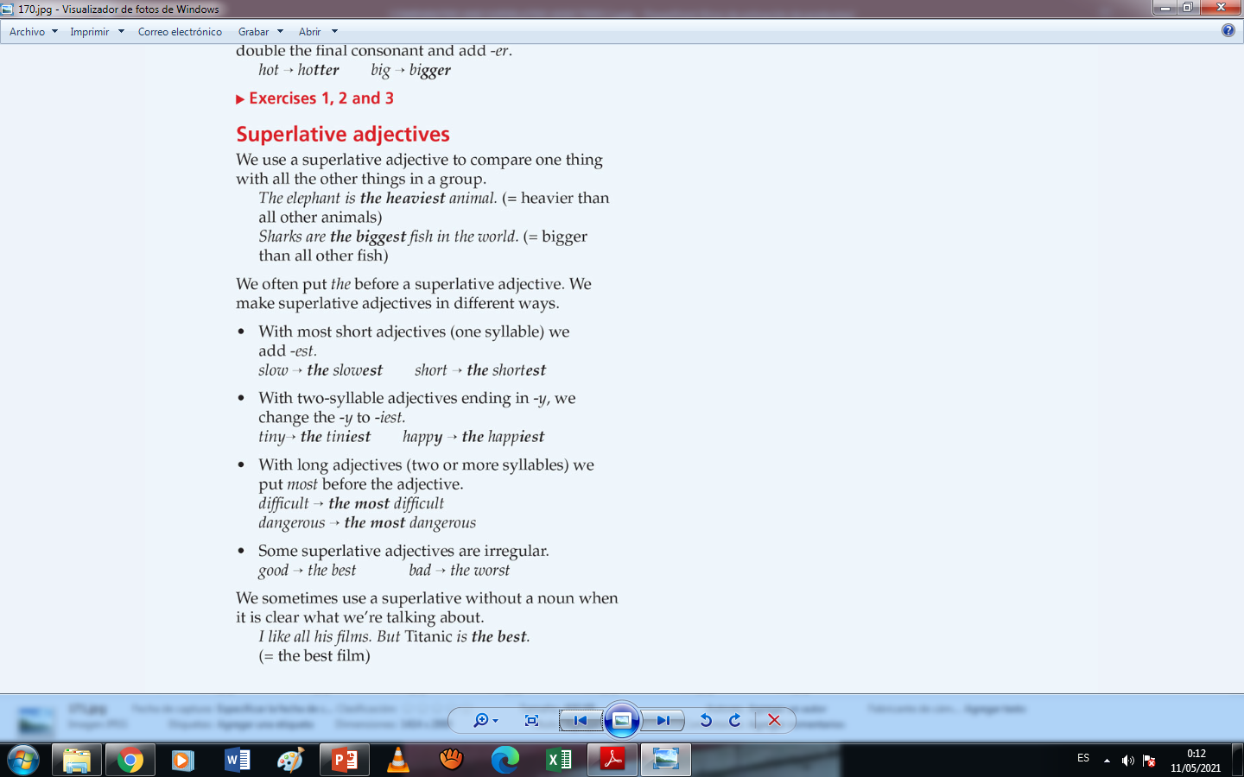
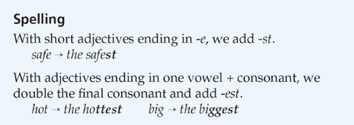

Slide 4
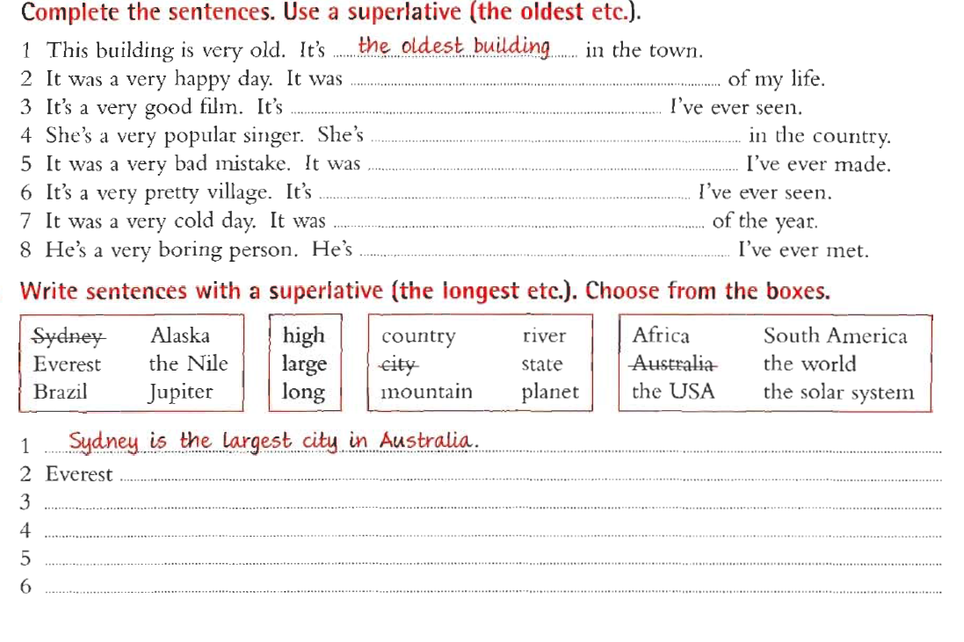
the happiest day
the best film
the most popular
the worst mistake
the prettiest village
the coldest day
the most boring person
is the highest mountain in the world.
Brazil is the largest country in South America.
Alaska is the largest state in the USA.
The Nile is the longest river in Africa.
Jupiter is the largest planet in the solar system.

Slide 5
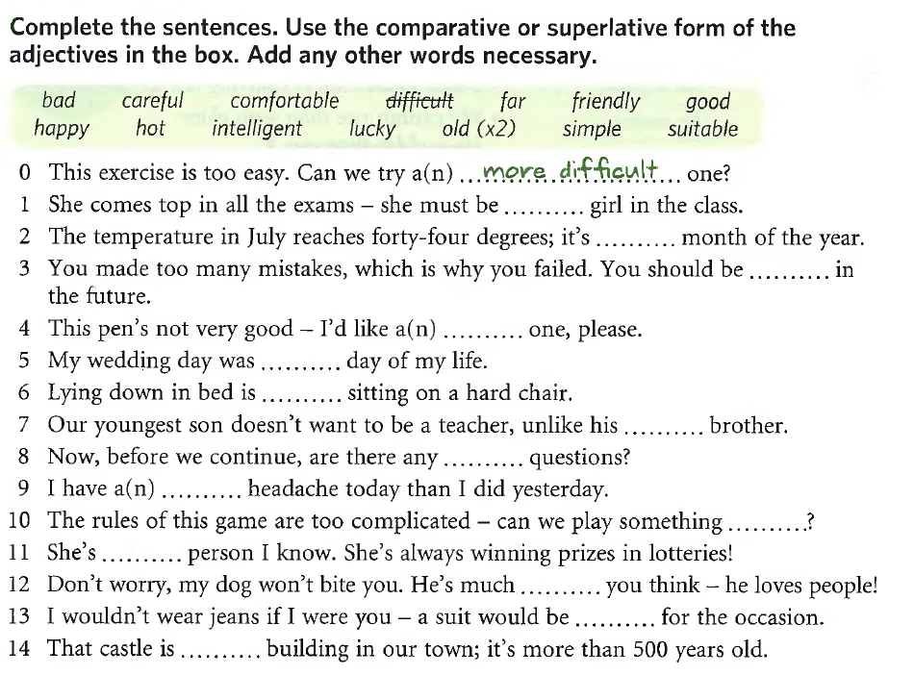
the most
intelligent
the hottest
more
careful
better
the happiest
more
comfortable than
older/elder
further
worse
simpler
the luckiest
friendlier
than
more
suitable
the oldest

Slide 6
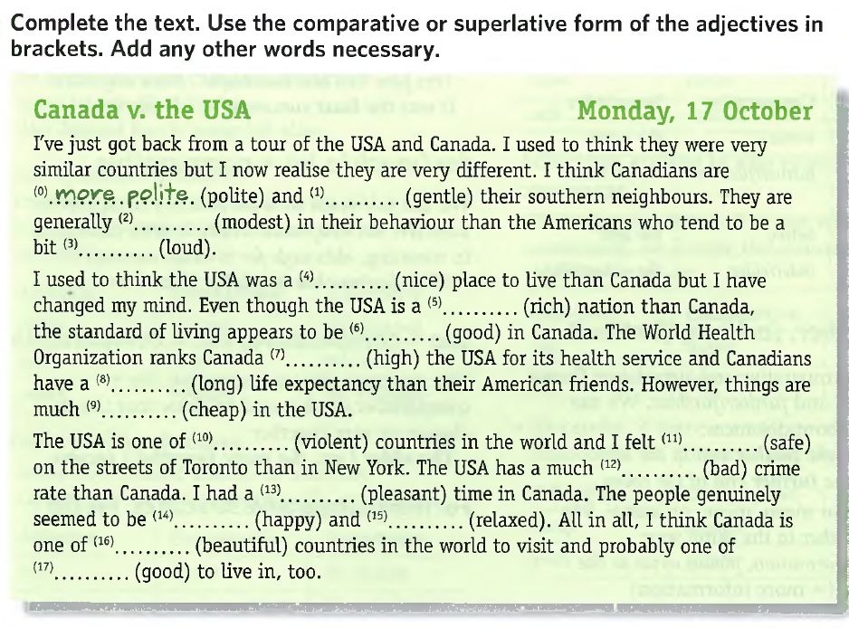
gentler than/
more gentle
more
modest
louder
nicer
richer
better
higher than
longer
cheaper
the most
violent
safer
worse
more
pleasant
happier
more
relaxed
the most
beautiful
the best

